Slide 1
Cepheids: the Leavitt Law

Slide 2
Introduction
Period-Luminosity relation PL of particular variable stars, used for distance measurements of SN and Galaxies, i.e. determining the Hubbe constant

Slide 3
History of PL relation

Slide 4
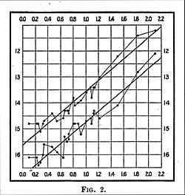
Notes:
Vortragsnotizen: ….

Slide 5
Annotation:
The previous page shows the plot from Leavitt's 1912 paper. The horizontal axis is the logarithm of the period of the corresponding Cepheid, and the vertical axis is its apparent magnitude. The lines drawn correspond to the stars' minimum and maximum brightness.

Slide 6
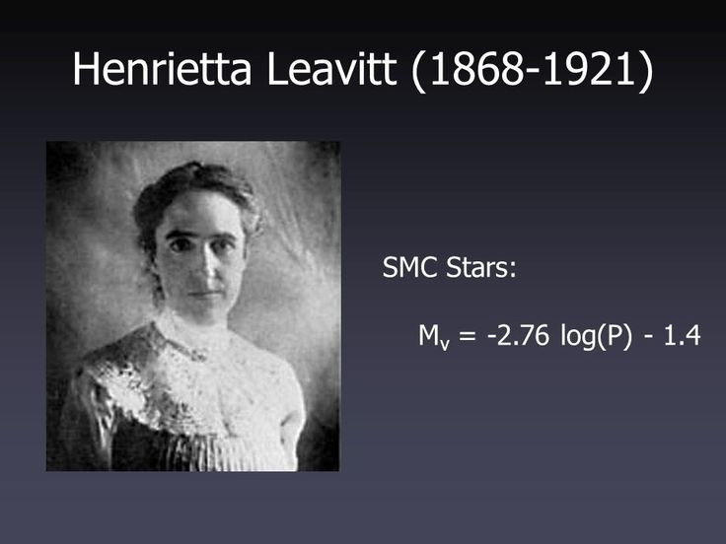

Slide 7

Harvard Computers of 1921

Slide 8
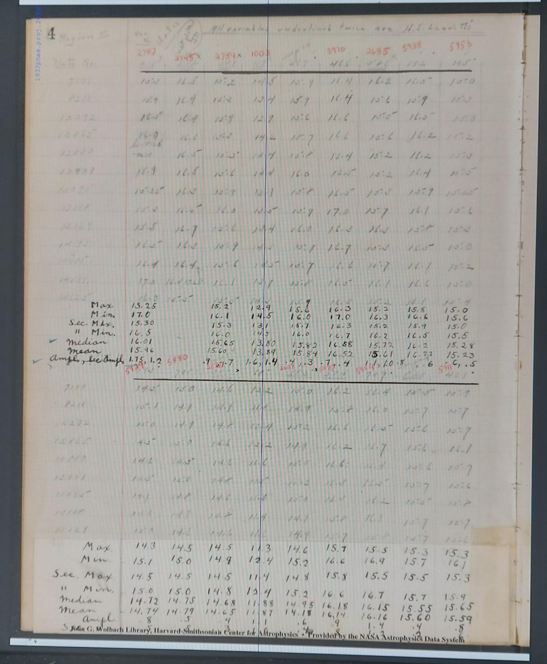
Data of 1908

Slide 10
Main Publication of the Project:
Breuval et al. , 2021:
The Influence of Metallicity on the Leavitt Law from Geometrical Distances of Milky Way and Magellanic Cloud Cepheids
PL : Period-Luminosity Relation
M = a log P + b + g[Fe/H]

Slide 11

Metallicity
X : H
Y: He
Z: all other Elements ( “Metals”)
Sun : X:Y:Z = 0,738 : 0,248 : 0,013
Metallicity: [Fe/H]
The unit often used for metallicity is the dex, contraction of "decimal exponent". By this formulation, stars with a higher metallicity than the Sun have a positive common logarithm, whereas those more dominated by hydrogen have a corresponding negative value.

Slide 12
Samples of Cepheids
MW Cepheids ( Milky Way)
LMC Cepheids ( Large Magellan Cloud)
SMC Cepheids ( Small Magellan Cloud)

Slide 13
Conclusion
We build large samples of Cepheids in MW and in the MCs using the most recent precise distances (Gaia data) available to estimate the Metallicity Effect to the PL relation.

Slide 14
Related Literature
Leavitt & Pickering , Original publication on PL, 1912 https://ui.adsabs.harvard.edu/abs/1912phae.proj..958L/abstract
Ripepi et al. 2021a,Cepheid Metallicity in the Leavitt Law (C-MetaLL) survey I-HARPS-N@TNC spectroscopy of 47 classical Cepheids and 1 Bl Her variables https://ui.adsabs.harvard.edu/abs/2022MNRAS.516.2887R/abstract
Trentin et al 2022 : Cepheid Metallicity in the Leavitt Law (C-MetaLL) survey: II. High resolution spectroscopy of the most metal poor Galactic Cepheids https://ui.adsabs.harvard.edu/abs/2023MNRAS.519.2331T/abstract
Molinaro R. et al. 2023 ,Cepheid Metallicity in the Leavitt Law (C-MetaLL) survey - III Simultaneous Deviation of the Gaia parallax offset and period-luminosity-metallicity coefficients https://ui.adsabs.harvard.edu/abs/2023MNRAS.520.4154M/abstract
Trentin et al. 2023, Cepheid Metallicity in the Leavitt Law (C-MetaLL) survey - IV The metallicity dependence of Cepheid Period-Luminosity relations https://ui.adsabs.harvard.edu/abs/2023arXiv231003603T/abstract
Ripepi et al. 2023 First spectroscopic investigation of Anomalous Cepheid variables https://ui.adsabs.harvard.edu/abs/2023arXiv231020503R/abstract

